Slide 1

One Site Does Not Fit All
Designing a COVID-19 Response Plan to Fit Your Needs

Slide 2


Meet Our Panelists
Leslie Nicholas
Carla Bachunas, CHMM
Ms. Nicholas is a Senior EHS Consultant with over 25 years of experience. Throughout her career, she has worked with various industrial clients on H&S programs designed to move facilities from generally “reactive” EHS approaches to programs of systematic and proactive planning. Her experience includes a wide variety of H&S Management, including Hazardous Chemicals and Hazard Communication, Emergency Action Planning, Injury and Illness Report, Bloodborne Pathogens, PPE Assessments, JHAs, CAPA Planning and Tracking, Management Systems, and Training,
Ms. Bachunas has worked in various aspects of EHS management for more than 25 years. Ms. Bachunas has held corporate EHS roles for companies manufacturing paperboard and packaging products, flat and automotive glass, and flat-rolled aluminum. Throughout her career, Ms. Bachunas has been responsible for the reduction of OSHA-recordable and lost-time injuries, the reduction of property losses, development of customized EHS procedures, and the training of managers, supervisors, and employees in EHS procedures and leadership. She is a certified auditor for ISO14001, OHSAS18001, and ISO45001.
Notes:
Artesia to introduce??

Slide 3

Introduction
COVID-19 – What it is (and is not)
State of the state(s)
Understanding Your Exposure Risks
General Guidelines
Hazard Assessments as a Risk Management Tool
Safe Workplaces
A Look to the Future
Diagram of Squiggly Lines
Real World Vapor Intrusion

Slide 4

COVID-19 is an Evolving State of Affairs
Daily bombardment of information from varied sources
Phases of reopening are changing and being revisited as new information comes in

Slide 5
Rely on input from Multiple Reputable Sources
Scientific and academic institutions
Government health agencies
Industry Associations
EHS Professional Groups

Slide 6
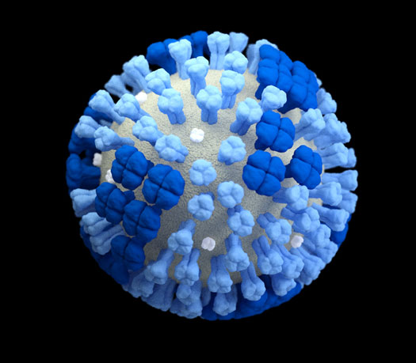
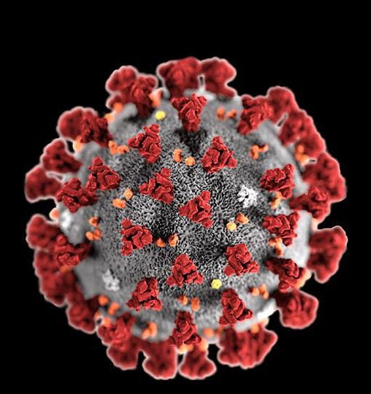


COVID-19: What is it?
Caused by the SARS-CoV-2 virus
Primarily affects respiratory system
No vaccine or widely available reliable treatment
Source: Center for Disease Control Image Library
Coronavirus
Influenza

Slide 7
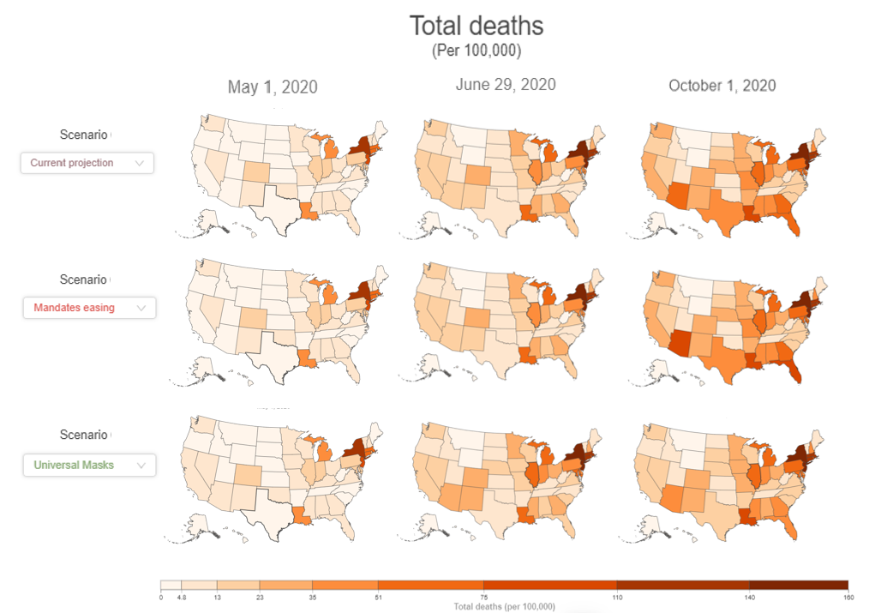
State of the State(s)
Large media focus on total deaths

Slide 8
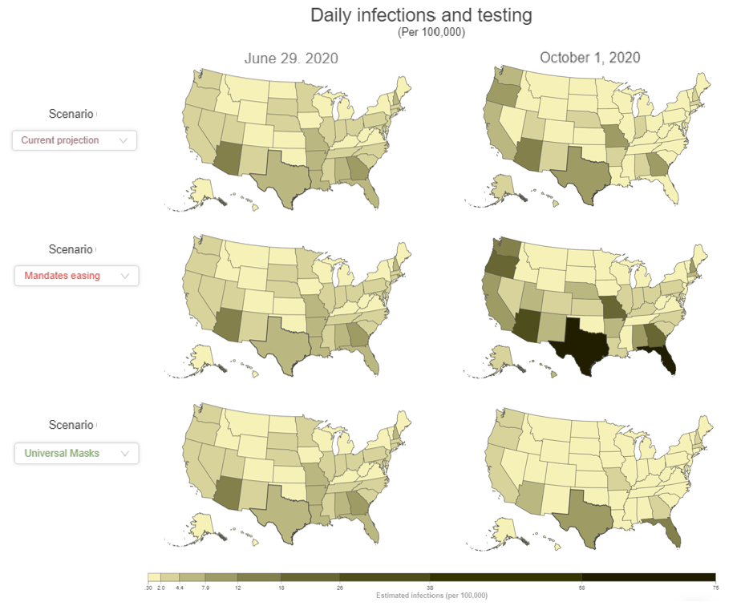
State of the State(s)
Large media focus on total deaths
Businesses may see a larger impact from infections
Reopening phases are based on multiple factors
Total infections and deaths
Positivity rates
Hospital capacities
Testing capacity

Slide 9

COVID-19 Exposure Risks
Business Risks of COVID-19
Employee Health & Safety
Continuity of Operations
Understanding how infection spreads can reduce these risks
Notes:
Understand how the virus spreads
Person to person
Respiratory droplets
Health screenings
Recognizing symptoms
Fit to work scenarios
Educating workers and colleagues

Slide 10
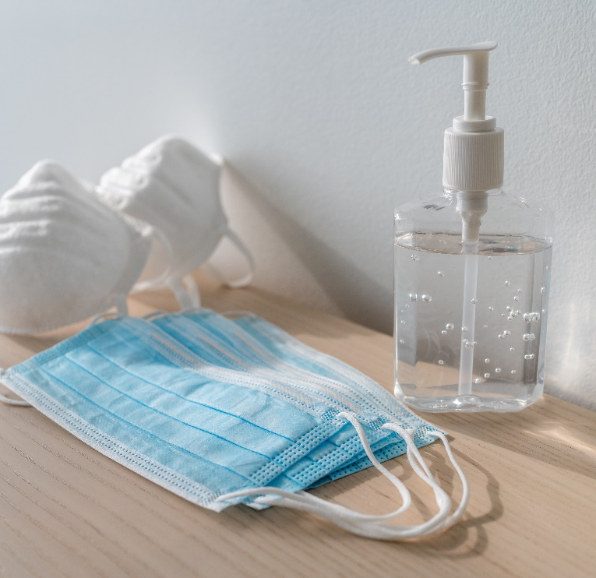

Applying Agency Health Recommendations to Business
CDC Guidance
General Health Recommendations for daily life
Workplace Health Recommendations
OSHA Guidance
No COVID-specific OSHA standards
Workplace preparedness planning
Hazard recognition and assessment

Slide 11

Hazard Assessment
Department/Area Specific
Physical (social) distancing
Personal hygiene/cleaning and disinfecting protocols
Current PPE in-use
Notes:
Now that we know a little more about the SARS-CoV-2 virus and COVID-19 lets focus on how to protect employees in the workplace and at home. The OSHA General Duty Clause requires employers to provide a safe and healthy workplace. This can be accomplished by conducting a hazard assessment of the workplace. The same can be done to identify hazards related to COVID-19.
The hazard assessment should be conducted each department or area of the plant or facility, including office areas and other common areas. Each area can present unique differences that should be assessed since the mitigation measures may be different for each area.
The hazard assessment should review operations to determine if employees are able to maintain a six-foot separation during the manufacturing process. It is important to watch the entire process from beginning to end since there may be a step where employees are required to work in close proximity with each other. Ask questions of the employees and brainstorm ideas on what can be changed or implemented to maintain a six-foot distance. Always include the employees conducting the task and ask for their input. Keep in mind, the close proximity of employees may be a habit and not a need. It is also important to watch the same operation on all shifts to see if there are any variations in how the task is conducted.
The department hazard assessment should include a review of personal hygiene facilities. Do employees have access to a handwashing facilities or hand sanitizers that can be used throughout the day?
PPE hazard assessments should be reviewed to determine if the PPE in use is appropriate for protection against SARS-CoV-2 virus.
The facility should review cleaning and disinfecting procedures to determine if any additional procedures should be taken to kill the SARS-CoV-2 virus. As part of the hazard assessment the facility should review the list of cleaners that can kill the virus that is located on the EPA website.
Although not part of a department hazard assessment, the facility management should also work with the HR group to determine what procedures to follow if an employee is diagnosed with COVID-19 or is experiencing symptoms of COVID-19.

Slide 12
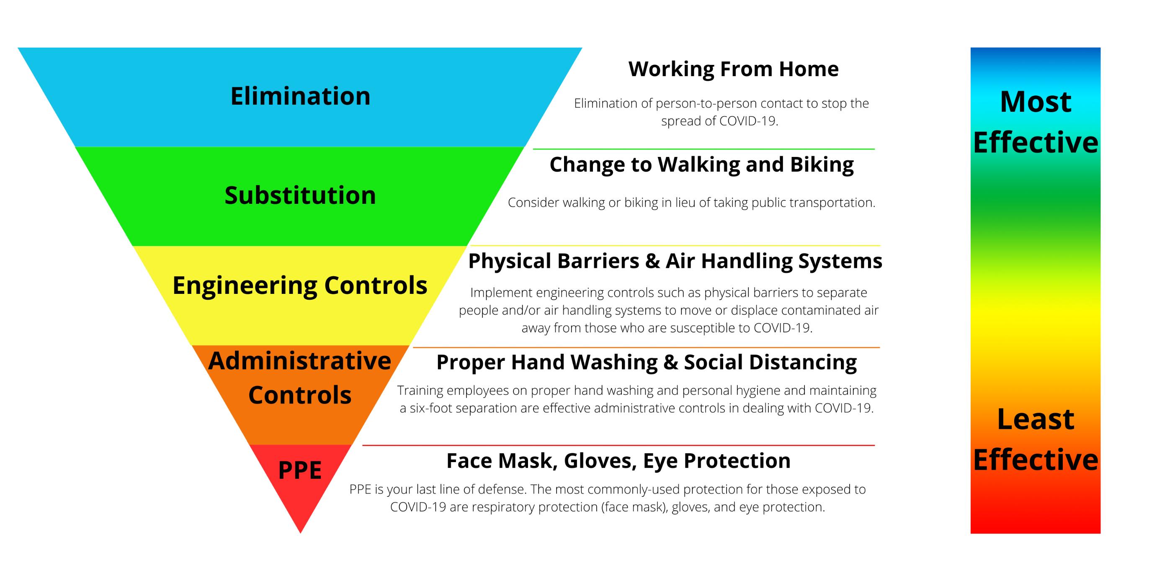
Hierarchy of Controls
Notes:
The hierarchy of controls is a system used in industry to minimize or eliminate exposure to hazards. The hierarchy of controls start with the most effect means of controlling a hazard to the least effective. The controls are elimination, substitution, engineering controls, administrative controls, PPE. These controls can also be applied to the COVID-19 pandemic.
Elimination
Although it is the most effective, elimination can be the most difficult control to implement. When focusing on COVID-10 eliminating person to person contact can stop the spread of the disease. While this may be difficult to do employees should be encouraged to work from home if that is possible.
Substitution
Depending on where you live, employees may take a bus, train, subway or other forms of public transportation to get to work or shopping. Encourage employees to change to walking or riding a bike when possible.
Engineering Controls are used to isolate workers from work-related hazards and reduce hazards without relying on worker behavior. When the hazard assessment is being conducted the feasibility of engineering controls should be reviewed. Engineering controls may include an inspection of the ventilation system to ensures it is operating properly, increasing ventilation rates and/or increasing the percentage of outdoor air that circulates into the system, installing high-efficiency air filters and installing temporary physical barriers.
Administrative Controls require an action be taken by the worker or employer and typically involve changes in policies or procedures to reduce or minimize exposure to a hazard. They rely more heavily on personal behaviors – not only on the part of workers, but also those of supervisors and managers. Administrative controls that can be implemented during the COVID-19 outbreak include requiring sick workers to stay at home, establishing extra shifts or alternating workdays to reduce the number of workers in the facility at a given time. If this control is put in place it is important for supervisors explain to their teams why shifts are changing, providing up-to-date information and training on risk factors and protective behaviors (e.g., hand washing, cough etiquette) as part of company communication as well as in routine safety meetings or tool box talks, and lastly, implementing safe work practices such as requiring routine hand-washing and disinfecting and cleaning of ‘high-touch’ surfaces. Make sure disinfectant solutions and disposable towels are readily accessible (and replenished) and consider no-touch trash cans.
PPE is the last line of defense. The hazard assessment should review exposures to employees to determine if any PPE is required. Employers must ensure workers are trained on what, if any, of the routine PPE they use can protect them against exposure to the SARS-CoV-2 virus. Training should also cover how to remove PPE that may have come into contact with potential sources of the virus. Employers should also provide training to help employees understand what would not be considered PPE for protection against the virus. For example, face coverings versus an N-95 or other type of respirator.

Slide 13
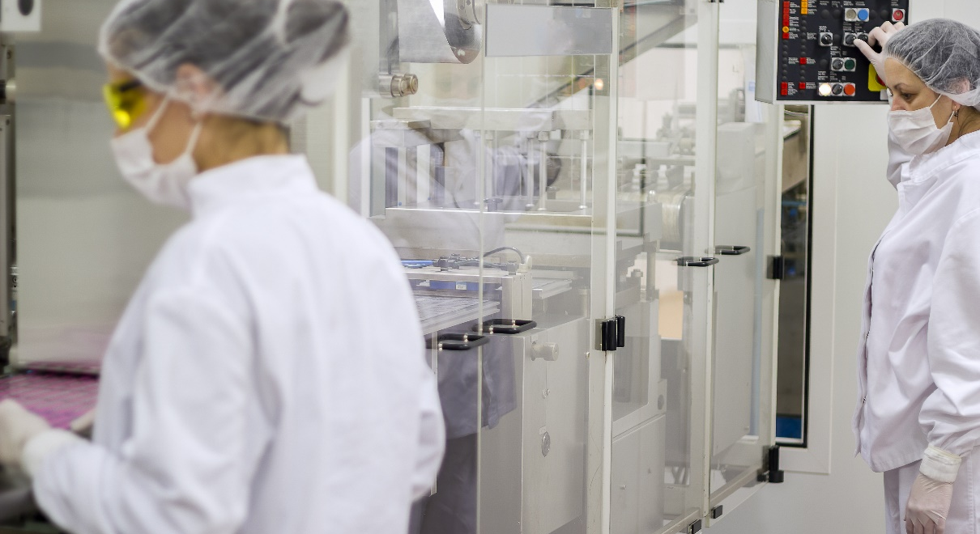
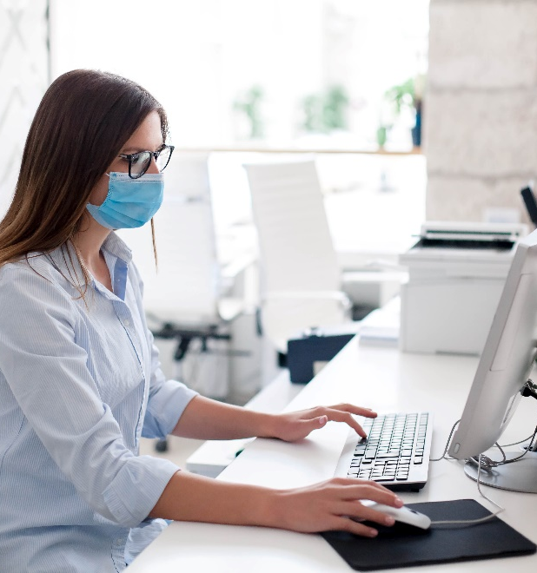
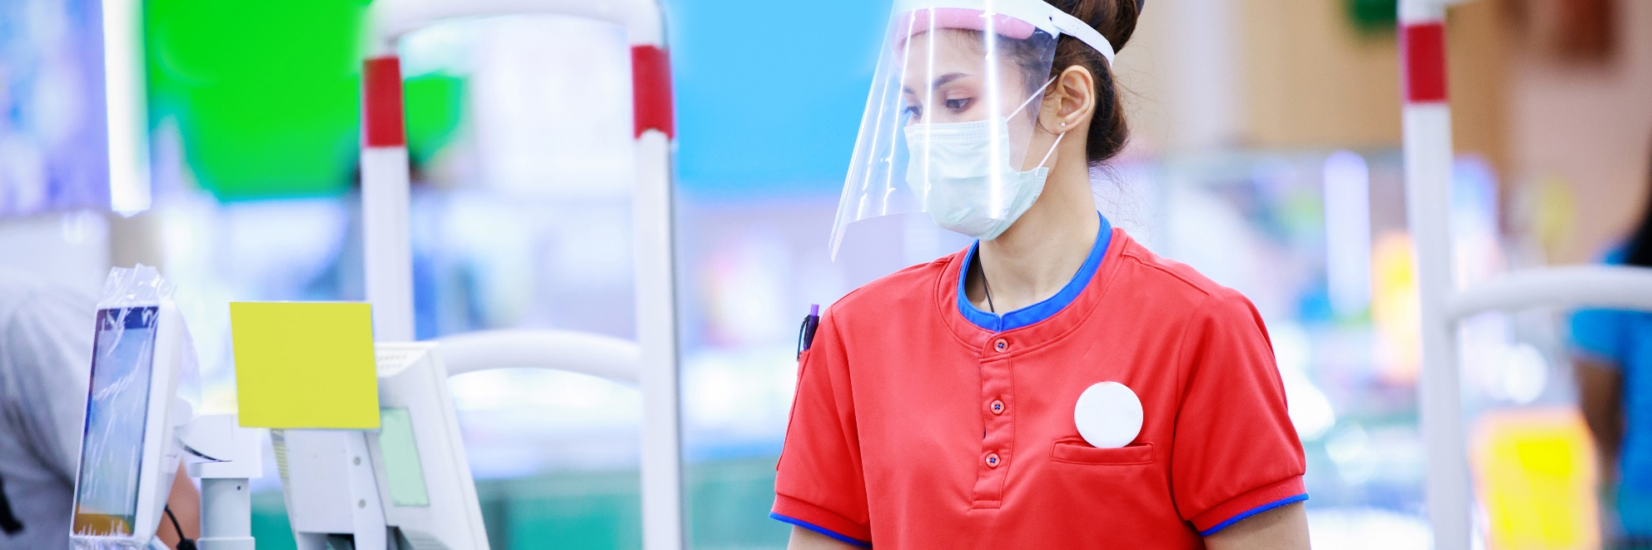
Manufacturing Areas
Installation of Barriers
Difficulties Hearing
Face Coverings
Notes:
The news has talked about stories of COVID-19 transmission in the meat packing industries. Employees in this industry are working shoulder to shoulder and are in close contact with one another which can rapidly increase the spread of the virus. There are many types of jobs that require employees to work in close proximity with others throughout the day or at least part of the day. All types of industries and retail establishments have been installing physical barriers to help prevent the spread of the disease. Installing barriers can be a challenge when employees are not standing side by side but are within 6 feet of each other. Creative ideas will likely be needed in these situations. Also look at how the work area is set up. Can the workspace be rearranged so workers are standing back to back and not facing each other?
Whether a barrier is used or not employees may be wearing face coverings. BBJ Group has received feedback from a facility that one of the biggest complaints they have received is with hearing others when they are wearing face coverings. Anyone who has been in a manufacturing facility knows it can be very difficult to hear someone in the plant in general and that is increased when they are wearing a face covering. To hear, a person tends to get closer to the person speaking and they may now be within 6 feet of each other. A hardhat compatible headset with microphone might be a solution. Again, creative ideas may be needed to address the problem.
Now that summer has arrived heat stress is a concern if employees are wearing face coverings all day in hot manufacturing environments. Extra breaks or cooling areas may be needed. Shifting work hours to the early morning when the plant is cooler is another option to consider.
When considering administrative or engineering controls, a committee comprised of hourly employees conducting the tasks should be established. The committee should also include EHS, engineering/maintenance and management. The committee should review different tasks and scenarios to come up with solutions that may include physical barriers or alternative controls in situations where wearing a face covering might create additional risks. It is important to include the employees who do the work when developing mitigation measures.

Slide 14
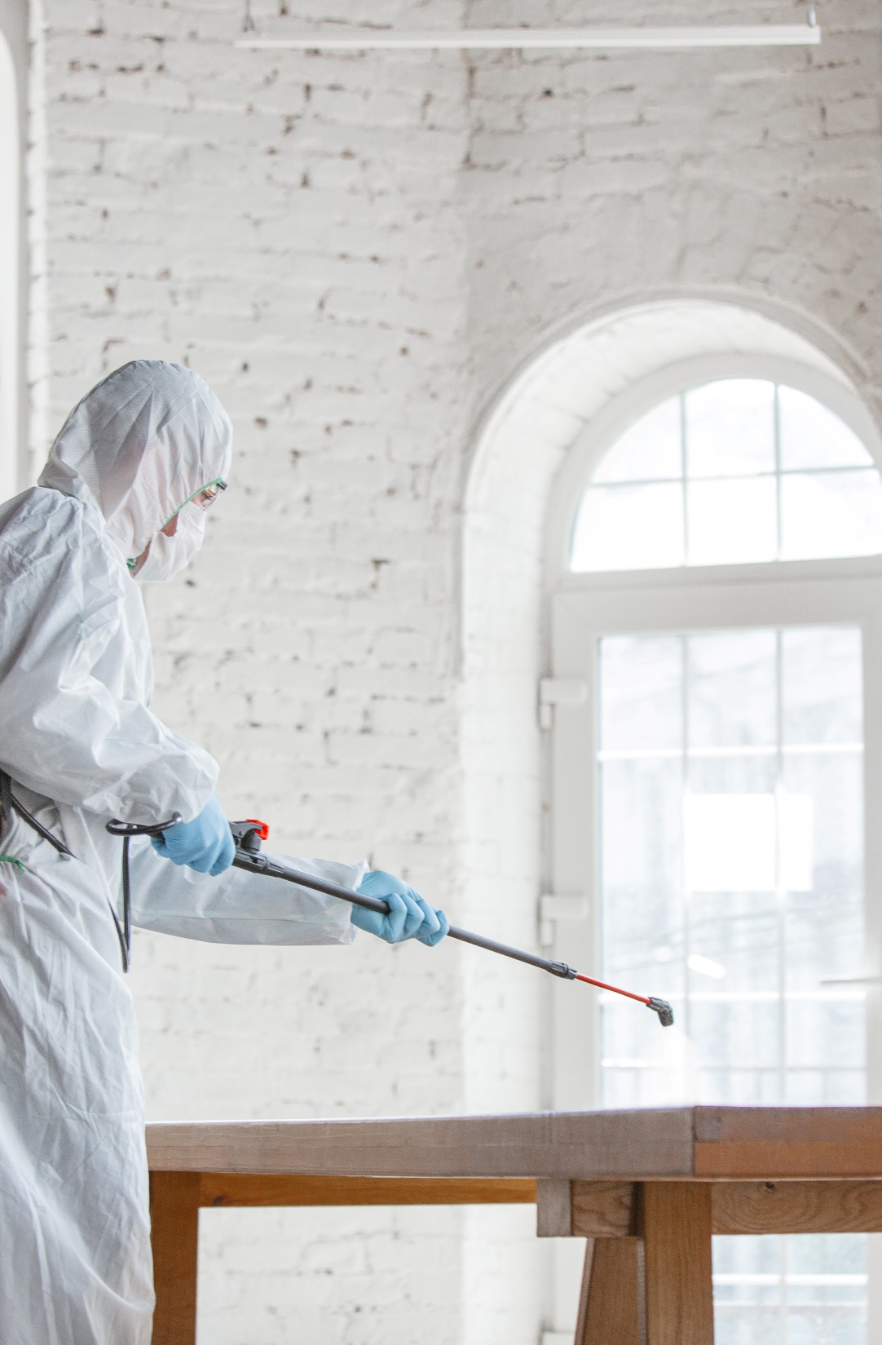
In-House Disinfecting
Cost savings and increased frequency
OSHA Regulations
Respiratory protection
Hazard communication
PPE Hazard assessment
Chemical Storage
Notes:
I want to talk a bit about cleaning and disinfecting. We had a client who closed their facility several times to have a third party contractor disinfect after employees tested positive for COVID-19. The facility was advised that the disinfectant would only last for 72 hours so every three days they were having the facility disinfected. Facility management made the decision to purchase the equipment and bring the disinfecting operations in-house to ensure frequent cleaning. This decisions also had long term cost savings. During our discussions with the facility we learned they did not have a respiratory protection program in place which includes a written program, medical screening and fit testing. We also discussed other OSHA regulations including hazard communication, PPE hazard assessments, and chemical storage were applicable.

Slide 15
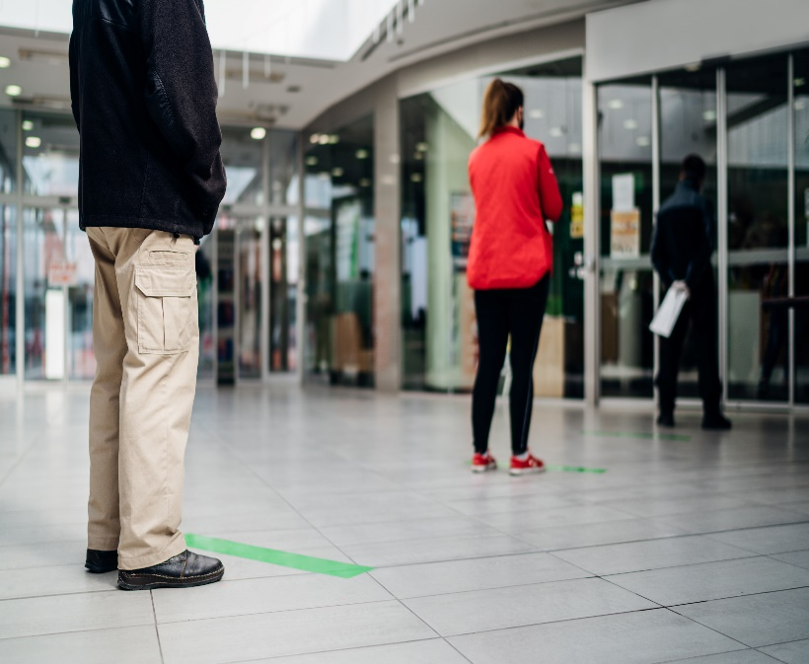
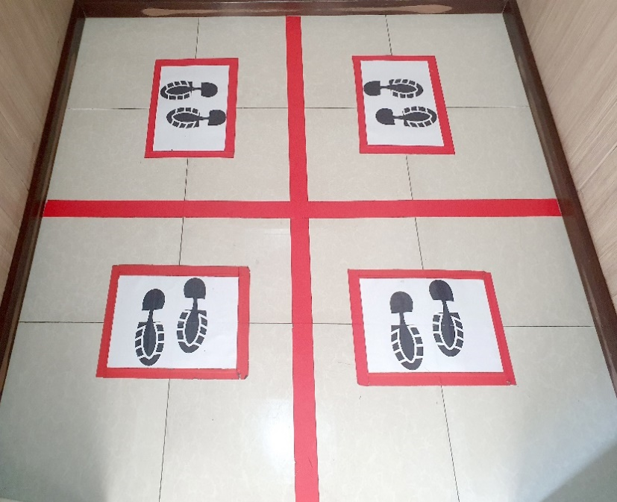
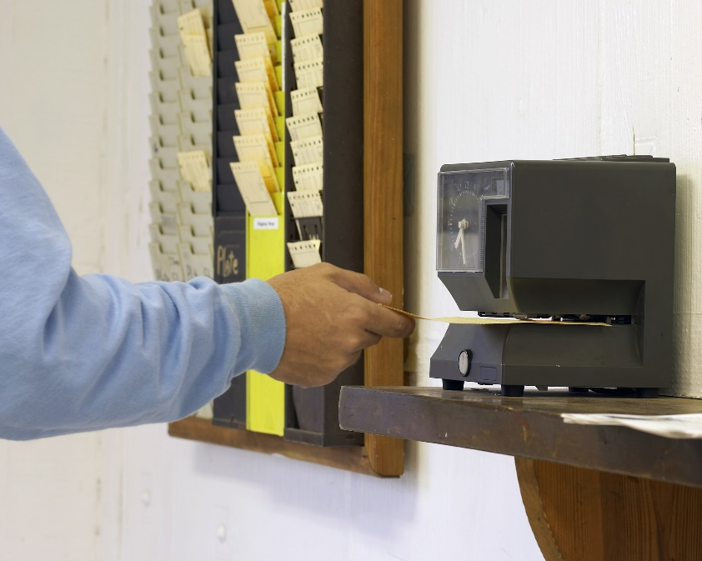

Shared Spaces
Office areas
Conference rooms
Break room/coffee stations
Smoking areas
Time clock
Elevator
Notes:
I mentioned that when completing the hazard assessments it is important to look at shared spaces including office areas, conference rooms, break rooms, smoking areas, time clock and elevators.
The hierarchy of controls should also be used to determine mitigation controls for common areas. As mentioned eliminate the hazard by having employees work from home, if possible. If employees are working in the office they may be sitting within 6 feet of each other or are working in an open office format. Engineering controls (barriers) can be installed to provide protection for employees. Another option to consider is limiting the number of employees in the office at any one time or removing work stations to ensure a six-foot separation.
Conference rooms and break rooms are other common area to assess. Limit seating around a conference table by removing chairs. Lunch room tables may need to be limited to one person per table. Barriers on or between tables can be installed to provide additional protection for employees.
Elevators are an area of close, closed-in contact. I have been on plenty of elevator rides where not one more person can be crammed into the elevator. This must change in the time of COVID-19. The photo above shows an elevator into quadrants for people to stand in and limits the elevator to four individuals. Even if the elevator is not partitioned be aware of the 6 foot distance.
Time clock areas in manufacturing plants are often crowed at shift change. Placing boxes or tape at 6-foot intervals on the floor will remind employees to maintain a 6 foot separation. Shift times can also be reviewed to determine if they can be staggered to reduce the lines at the time clocks.
Smoking areas are often small covered picnic tables outside a manufacturing plant or are limited to one area outside an office building. Conduct a hazard assessment to determine what can be done to provide adequate space for social distancing. You may also want to consider offering smoking caseation programs for employees.

Slide 16

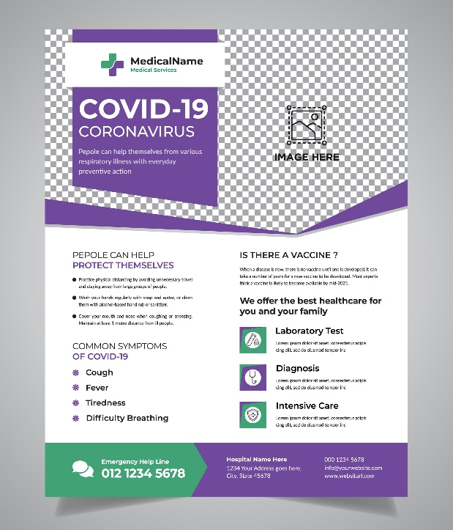

Staying Safe at Home
Educate employees
Handouts
Face coverings and gloves
Notes:
We have been hearing from clients that they can’t control the activities of employees outside of work and what they are doing can expose them to the SARS-CoV-2 virus. For that reason, education on how employees can stay safe outside of work is key. Employees may hear inaccurate information from family, friends, and social media. It is important to provide employees factual information so they understand what the virus is, how it spreads and how they can protect themselves. Education should be on-going throughout the pandemic and can include information on how to stay safe during re-opening phases or what to do during a resurgence. We are entering a period of COVID fatigue and keeping the discussions going will hopefully remind employees that the pandemic is ongoing and they need to continue to keep themselves safe for their family and loved ones. These discussions can be short but it is important that they continue.
Employers can also provide handouts or electronic information and encourage employees to share the information with family and friends. Stress the need to share the information so others know what to do to protect themselves when they are in public.
A company should consider purchasing face coverings and gloves for employees to take home for their families to use to stay safe. Doing small things to show you care can go a long with employees. As Leslie mentioned earlier, if people are healthy and happy quality and production will benefit.
COVID-19 cases are increasing in several US states. However, the use of face coverings and practicing hand washing can help reduce the spread of the virus. They sound simple but these practices work. You may have heard the story of two hairstylists in Missouri who were showing symptoms of COVID-19 but continued to work potentially exposing 140 people. However, none of their clients became ill. The stylists wore masks, as did their clients. The salon also implemented Centers for Disease Control measures like keeping chairs at least 6 feet apart and staggering appointments. This case shows that wearing masks and following CDC guidelines can make an impact.

Slide 17
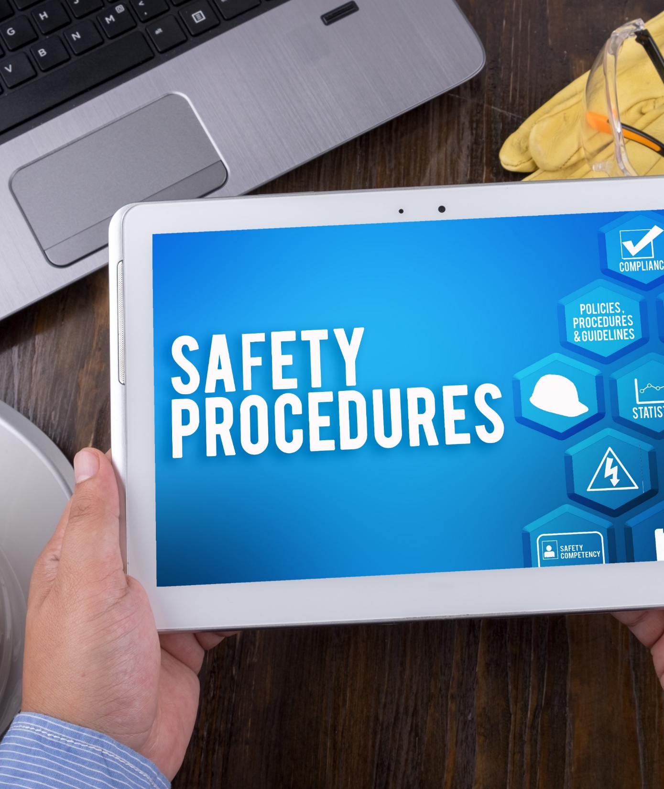
Document using a Systematic Approach
Assign a COVID-19 Response Team
Plan communication strategy
Obtain and evaluate community health updates
Review and update hazard assessments
Train and educate

Slide 18
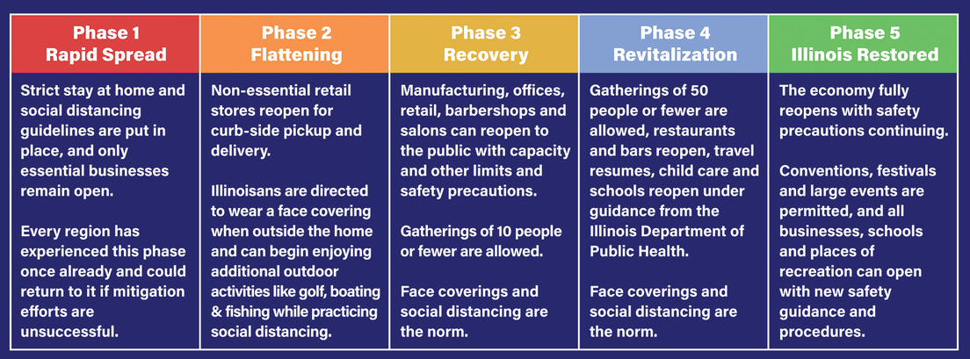

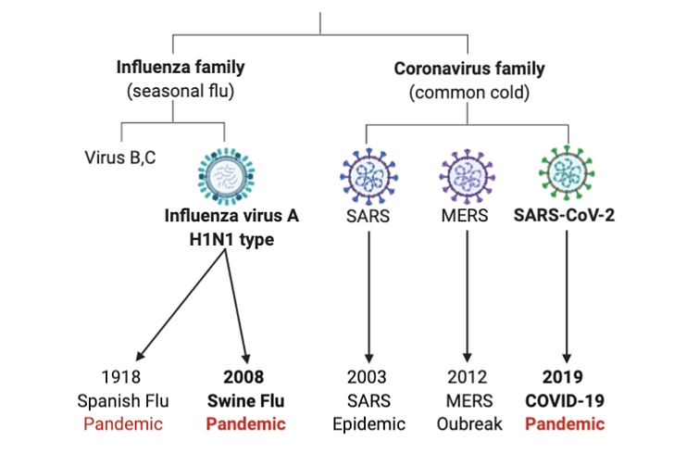
A Look to the Future
States moving in and out of different phases
COVID-19 “Spikes”
Effect of seasonal flu
Future pandemics
Source: Biology in Context

Slide 19

Key Takeaways
COVID-19 presents a new and changing dynamic for managing businesses
Hazard recognition tools can be used to assess and manage your COVID-19 risks – and prepare you for future concerns
Communicating with and educating your workforce can help ensure success
Planning for the future requires vigilance and flexibility

Slide 20

Questions?

Slide 21

Get in Touch
WEB:
www.bbjgroup.com
PHONE:
800 875 1756
EMAIL:
info@bbjgroup.com
DOWNLOAD:
Webinar Recording: bbjgroup.com/resources

